Slide 1
COMPUTER VISION SERIES
YOLO Object Detection
Complete Guide: From Beginner to Advanced
Exam & Interview Prep
Deep Learning

Slide 2
PRESENTATION OVERVIEW
What We'll Cover
01
Object Detection Basics
02
Two-Stage vs One-Stage
Classification, Localization, Detection, Segmentation
R-CNN vs YOLO approaches compared
03
Introduction to YOLO
04
Grid Cells & Bounding Boxes
You Only Look Once - The revolutionary approach
Core prediction mechanism explained
05
Intersection Over Union (IoU)
06
Non-Max Suppression (NMS)
Measuring prediction accuracy
Eliminating duplicate detections
07
Anchor Boxes
08
YOLO Architecture
Handling multiple objects per cell
Backbone, Neck, and Head components
09
YOLO Evolution
10
Applications & Q&A
From v1 to v8+ improvements
Real-world use cases & exam questions

Slide 3
FOUNDATION CONCEPTS
Object Detection: The Basics
Classification
Object Detection
What: Identifying what object is present in an image.
Combined: Detecting multiple objects with their locations and classes.
Example: Given an image, output: "Dog" or "Cat"
Example: Finding all cars, pedestrians, bikes in an image
Input: Image → Output: Class label
Input: Image → Output: Multiple boxes + classes
Localization
Image Segmentation
Where: Finding the location of a single object with a bounding box.
Pixel-level: Dividing image into segments at pixel level.
Output: (x, y, width, height) + class label
Types: Semantic (classes) vs Instance (individual objects)
Input: Image → Output: Box coordinates
Input: Image → Output: Pixel mask
Key Insight: Object Detection = Classification + Localization for multiple objects. YOLO does this in a single forward pass!

Slide 4
DETECTOR COMPARISON
Two-Stage vs One-Stage Detectors
Two-Stage Detectors
One-Stage Detectors
R-CNN, Fast R-CNN, Faster R-CNN
YOLO, SSD, RetinaNet
How It Works
How It Works
Stage 1: Generate region proposals (RPN - Region Proposal Network)
Single Pass: No region proposals needed
Stage 2: Classify each region + refine bounding boxes
Direct Prediction: Class + bounding box in one go
Pros
Pros
Higher accuracy - especially for small objects
Extremely fast - 45-500+ FPS
Fewer false positives - refined classification
Simple - end-to-end architecture
Flexible - can add mask branch (Mask R-CNN)
Efficient - ideal for edge devices
Cons
Cons
Slower - 5-20 FPS on GPU
Lower accuracy - especially small objects
Complex - harder to optimize end-to-end
More false positives - dense prediction
Region proposal bottleneck
Struggles with overlapping objects
When to Choose: Use Two-Stage for accuracy-critical tasks (medical imaging, research). Use One-Stage for real-time applications (autonomous driving, surveillance).

Slide 5
THE REVOLUTIONARY APPROACH
Introduction to YOLO: You Only Look Once
What Makes YOLO Special?
Key Advantages
YOLO, introduced by Joseph Redmon in 2016, revolutionized object detection by framing it as a single regression problem instead of a multi-stage pipeline.
Speed
One forward pass = real-time detection
Traditional Approach: Region proposals → Feature extraction → Classification (multiple steps)
YOLO Approach: Image → Single CNN → Bounding boxes + Classes (one step)
Global Context
Sees entire image, reduces background errors
Real-Time Speed
Good Accuracy
End-to-End
45+ FPS
63.4%
Joint training, no complex pipeline
On standard GPU hardware
mAP on PASCAL VOC 2007
Generalizable
Learns representations transferable to new domains
How YOLO Works (Simplified)
1
Divide image into S×S grid (e.g., 7×7)
Why "You Only Look Once"?
2
Process entire image through CNN once
Because unlike other detectors that examine regions multiple times, YOLO processes the entire image just once through a single neural network!
3
Predict bounding boxes + class probabilities for each grid cell
4
Apply thresholding and NMS to get final detections

Slide 6
CORE MECHANISM
Grid Cells & Bounding Boxes
Grid System
Output Tensor Shape
YOLO divides the input image into an S×S grid. Each grid cell is responsible for detecting objects whose center falls within that cell.
S × S × (B × 5 + C)
7×7
19×19
S×S = Grid dimensions
YOLOv1
YOLOv3+
B = Boxes per cell
5 = [Pc, bx, by, bw, bh]
C = Number of classes
Key Rule: If an object's center is in a cell, that cell predicts the object.
Example: 7×7 grid, 2 boxes/cell, 3 classes
Bounding Box Parameters
7 × 7 × (2×5 + 3) = 7×7×13 = 637 values
Each grid cell predicts B bounding boxes with 5 values each:
Pc
Confidence Score
Probability that an object exists (0-1)
Coordinate System
bx
X Coordinate
(0,0)
Center x relative to cell (0-1)
by
Y Coordinate
Center
Center y relative to cell (0-1)
(1,1)
Width
All coordinates normalized to 0-1 range
bw
Box width (can be >1, spans cells)
bh
Height
Important: bx, by are always 0-1 (within cell), but bw, bh can exceed 1 (box spans multiple cells).
Box height (can be >1, spans cells)

Slide 7
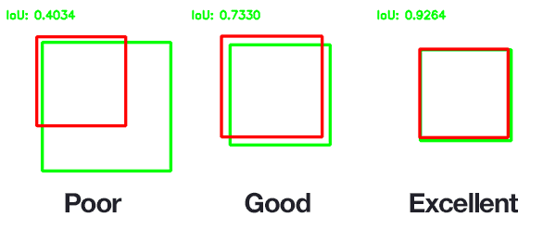
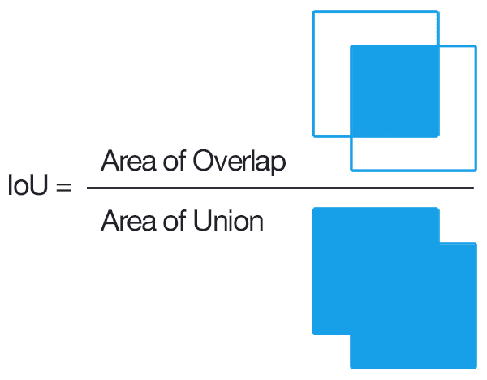
ACCURACY METRIC
Intersection Over Union (IoU)
What is IoU?
Visual Examples
IoU measures the overlap accuracy between a predicted bounding box and the ground truth (actual) box.
IoU = Area of Intersection / Area of Union
Numerator
Denominator
Overlap region
Total combined area
Different IoU values showing prediction quality
IoU Interpretation
IoU Formula Visualization
1.0
Perfect Match
Boxes completely overlap
≥0.5
Correct Detection
Standard threshold
0.0
Intersection area divided by Union area
No Overlap
Boxes don't touch
Why IoU Matters
Evaluates bounding box prediction quality
Used in Non-Max Suppression (NMS)
Determines true positives vs false positives

Slide 8
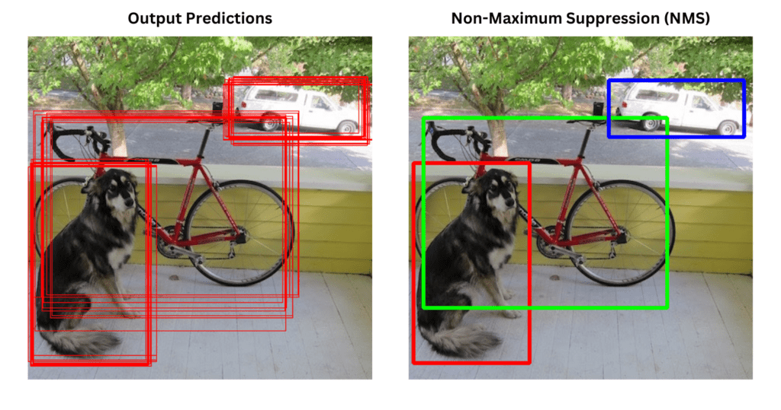
POST-PROCESSING TECHNIQUE
Non-Max Suppression (NMS)
The Problem
NMS in Action
YOLO can predict multiple overlapping bounding boxes for the same object, especially when using many grid cells. Each cell might claim to detect the same object with high confidence.
Example Scenario:
A single dog in an image might generate 10+ overlapping boxes from nearby grid cells, all claiming to detect the dog.
NMS Algorithm (Step-by-Step)
Before: Multiple boxes → After: Single box per object
1
Filter Low Confidence
Discard all boxes with Pc < 0.6 (threshold)
Key Parameters
2
Sort by Confidence
Confidence Threshold
Sort remaining boxes by Pc (highest first)
Typically 0.6 - removes weak predictions
3
Select Best Box
IoU Threshold
Pick the box with highest Pc as a detection
Typically 0.5 - defines "same object"
4
Remove Overlaps
Discard all boxes with IoU ≥ 0.5 with selected box
Key Point: NMS runs independently for each class in multi-class detection!
5
Repeat
Go to step 3 until no boxes remain

Slide 9
HANDLING MULTIPLE OBJECTS
Anchor Boxes: The Solution
The Limitation
How Anchor Boxes Work
Without anchor boxes, each grid cell can only detect ONE object. What if multiple objects with different shapes are in the same cell?
1. Pre-defined Shapes
Select 5-10 common aspect ratios (e.g., using K-means clustering on dataset)
Problem Scenarios:
2+ objects in same cell
2. Assignment Rule
Objects with different aspect ratios
Object assigned to grid cell + anchor box with highest IoU
Overlapping objects of different classes
3. Multiple Predictions
Each cell now predicts B×(5+C) values per anchor
What are Anchor Boxes?
Anchor boxes are pre-defined bounding box shapes based on common object aspect ratios in the dataset.
Updated Output Shape
Example Anchor Boxes:
S × S × A × (5 + C)
A = Number of anchor boxes
Wide
Square
5 = [Pc, bx, by, bw, bh]
Tall
2:1
1:1
C = Number of classes
1:2
Example: 7×7 grid, 2 anchors, 3 classes
7 × 7 × 2 × (5+3) = 784 values
Intuition: Humans are tall, cars are wide, signs are square. Different shapes need different anchors!
Limitations
Can't detect more objects than anchors per cell
Similar-shaped objects in same cell = conflict

Slide 10
NETWORK STRUCTURE
YOLO Architecture Explained
Backbone
Neck
Head
Feature Extraction
Feature Fusion
Detection Output
CNN that extracts hierarchical features from the input image.
Bridge between backbone and head. Aggregates features from different scales.
Final layer that produces predictions: bounding boxes + class probabilities.
Functions
Captures edges, textures (early layers)
Functions
Functions
Complex patterns (deep layers)
Concatenates multi-scale features
Generates bounding boxes
Multi-scale representations
Upsampling + downsampling
Assigns confidence scores
Integrates contextual info
Classifies objects
Examples
Darknet-53, ResNet, CSPDarknet
Examples
Output
FPN, PANet, BiFPN
S×S×A×(5+C) tensor

Slide 11
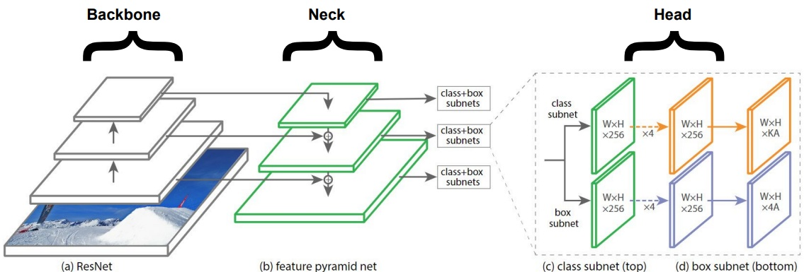
NETWORK STRUCTURE
YOLO Architecture Explained
Backbone → Neck (Feature Pyramid) → Head (Detection)

Slide 12
TRAINING OBJECTIVE
YOLO Loss Function
Multi-Part Loss
3. Classification Loss (Lclass)
YOLO uses a combined loss function with three components, each weighted differently to balance their importance.
Penalizes incorrect class predictions when an object is present.
Formula:
Total Loss = λ₁Lcoord + λ₂Lconf + λ₃Lclass
Cross-entropy loss between predicted and true class probabilities [C1, C2, C3, ...]
Jointly trained using backpropagation
Applied only when object exists in cell (Pc = 1)
1. Coordinate Loss (Lcoord)
Loss Component Summary
Penalizes errors in bounding box coordinates (center and dimensions).
Coordinate Loss
Box position & size
HIGH
Formula:
MSE between predicted and ground truth [bx, by, bw, bh]
Confidence Loss
MEDIUM
Weight: Higher λ (e.g., 5) because precise localization matters
Object presence
Classification Loss
MEDIUM
2. Confidence Loss (Lconf)
Object category
Penalizes errors in objectness prediction (Pc - probability of object).
Two Cases:
Key Insight: Different weights ensure the model doesn't prioritize one aspect over others. Localization typically gets highest weight!
• Object present: Pc should be 1
• No object: Pc should be 0
Weight: Lower λ for no-object cells (e.g., 0.5) to avoid dominating

Slide 13
HISTORICAL PROGRESSION
Evolution of YOLO: v1 to v8+
v1
YOLOv1
v2
YOLOv2
v3
YOLOv3
2016
2017
2018
Key Innovation
Key Improvements
Key Improvements
First unified, real-time detector
Batch norm, anchor boxes
Darknet-53, 3 scales
Architecture
Architecture
Architecture
24 conv layers + 2 FC
Darknet-19 backbone
Feature Pyramid Network
Performance
Performance
Performance
45 FPS, 63.4% mAP
Better accuracy, multi-scale
Better small objects
v4
YOLOv4
v5
YOLOv5
v8
YOLOv8
2020
2020
2023+
Key Improvements
Key Improvements
Key Improvements
CSPDarknet, SPP, PANet
PyTorch, Ultralytics
Anchor-free, C2f, decoupled head
Architecture
Architecture
Architecture
Bag of freebies & specials
Auto-anchor, mosaic aug
Multi-task: det, seg, pose
Performance
Performance
Performance
SOTA speed-accuracy
Easy deployment
52-54% mAP, 100+ FPS
Trend: Each version improves speed, accuracy, and adds features (segmentation, pose estimation). Latest versions (YOLOv9-v12) focus on efficiency and NMS-free detection!

Slide 14
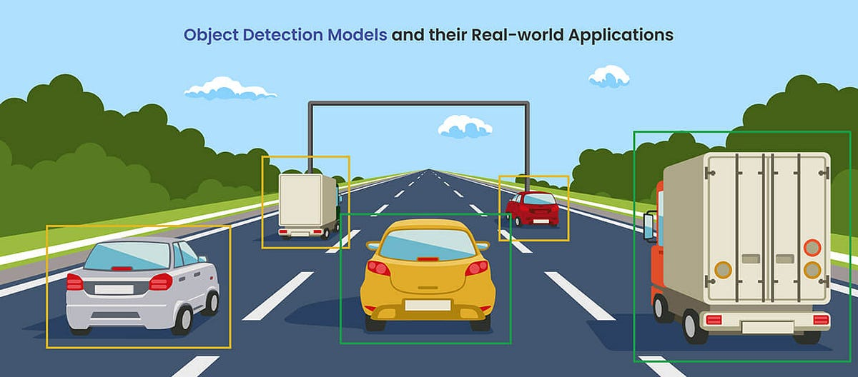
PRACTICAL USE CASES
Real-World Applications of YOLO
Autonomous Driving
Surveillance
Industrial Robotics
Real-time detection of pedestrians, vehicles, traffic signs, and obstacles.
Monitoring for suspicious activities, crowd counting, face detection.
Quality control, defect detection, assembly line automation.
Key Benefits
Key Benefits
Key Benefits
• High-speed inspection
• 45+ FPS for real-time decisions
• 24/7 real-time monitoring
• Consistent quality control
• Detects multiple object types
• Instant alerts for anomalies
• Pick and place operations
• Critical for safety systems
• PPE detection (helmets, vests)
Sports Analysis
Healthcare
Smart Home
Player tracking, ball detection, performance analytics.
Medical imaging, tumor detection, anomaly identification.
Security cameras, interactive assistants, object recognition.
Key Benefits
Key Benefits
Key Benefits
• Track fast-moving objects
• Real-time diagnostics
• Edge device deployment
• Tactical analysis
• Assists doctors in surgery
• Privacy-preserving (local)
• Broadcast enhancement
• Early disease detection
• Low latency response
Why YOLO for these applications? Its real-time speed (45-500+ FPS) combined with good accuracy makes it ideal for time-critical tasks where decisions must be made in milliseconds!

Slide 15
TEST YOUR KNOWLEDGE
Exam & Interview Questions: Part 1
Basic to Intermediate Level
Q1
What is the difference between classification, localization, and object detection?
Q4
Explain the sliding window problem and how YOLO solves it.
Answer:
Answer:
Classification: Identifies what object is in the image (label only)
Problem: Sliding window requires running CNN thousands of times at different locations and scales - extremely slow!
Localization: Finds location of single object (box coordinates)
Detection: Combines both for multiple objects (boxes + labels)
YOLO Solution: Divides image into grid, runs CNN once, and each grid cell directly predicts bounding boxes. This converts thousands of forward passes into just one!
Q2
Why is YOLO called "You Only Look Once"?
Q5
What is Non-Max Suppression and why do we need it?
Answer:
Unlike two-stage detectors (R-CNN) that first generate region proposals and then classify each region separately, YOLO processes the entire image in a single forward pass through one CNN, directly predicting bounding boxes and class probabilities simultaneously.
Answer:
NMS is a post-processing algorithm that removes duplicate bounding boxes for the same object.
Need: YOLO can predict multiple overlapping boxes for the same object (from nearby grid cells). NMS keeps only the best prediction by selecting highest confidence box and removing others with IoU ≥ threshold (typically 0.5).
Q3
What is IoU and why is it important?
Answer:
Study Tip: Practice explaining these concepts in your own words. Interviewers value clear, intuitive explanations over memorized definitions!
IoU (Intersection over Union) measures the overlap between predicted and ground-truth bounding boxes:
IoU = Area of Intersection / Area of Union
Importance: Used to evaluate prediction quality, in NMS, and for calculating mAP. IoU ≥ 0.5 typically means correct detection.

Slide 16
TEST YOUR KNOWLEDGE
Exam & Interview Questions: Part 2
Advanced Level
Q6
Explain anchor boxes and their limitations.
Q9
What are the three components of YOLO loss function?
Answer:
Answer:
Anchor boxes are pre-defined bounding box shapes (based on dataset object ratios) that allow each grid cell to detect multiple objects.
1. Coordinate Loss: MSE for bounding box coordinates (bx, by, bw, bh)
2. Confidence Loss: For objectness prediction (Pc)
Limitations:
3. Classification Loss: Cross-entropy for class probabilities (C1, C2, C3...)
• Can only detect as many objects as anchor boxes per cell
• Struggles when similar-shaped objects overlap in same cell
• Requires careful selection of anchor sizes
Q10
Explain YOLO architecture: Backbone, Neck, and Head.
Answer:
Q7
How does YOLO assign objects to grid cells?
Backbone: CNN for feature extraction (e.g., Darknet-53, ResNet)
Neck: Feature fusion layer (FPN, PANet) that aggregates multi-scale features
Answer:
Head: Detection layer that outputs bounding boxes and class predictions
An object is assigned to the grid cell that contains its center point. With anchor boxes, it's assigned to the cell + anchor box pair with the highest IoU. The target output tensor has Pc=1 for that cell/anchor and Pc=0 for others.
Q11
When would you choose YOLO over Faster R-CNN?
Answer:
Q8
Compare two-stage (R-CNN) vs one-stage (YOLO) detectors.
Choose YOLO for real-time applications (autonomous driving, surveillance) where speed (45+ FPS) is critical. Choose Faster R-CNN when accuracy is paramount (medical imaging, research) and speed is less important.
Answer:
Two-Stage
One-Stage
Higher accuracy, slower (5-20 FPS), better for small objects
Faster (45+ FPS), simpler, good for real-time

Slide 17
CONCLUSION
Key Takeaways
YOLO Revolutionized Detection
Master Core Concepts
First unified, real-time object detector that processes images in a single forward pass, achieving 45+ FPS with good accuracy.
Understand Grid Cells, Bounding Boxes, IoU, NMS, and Anchor Boxes - these are fundamental to YOLO and frequently asked in interviews.
Speed vs Accuracy Trade-off
Continuous Evolution
One-stage (YOLO) for real-time, Two-stage (R-CNN) for accuracy. Choose based on your application requirements.
From v1 to v8+, YOLO keeps improving. Latest versions achieve 52-54% mAP at 100+ FPS with additional features like segmentation.
Practice for Success
Review the exam questions provided, implement YOLO on a small dataset, and be ready to explain concepts intuitively. Keep learning - the field evolves rapidly!
Good Luck with Your Exams & Interviews!
You Only Learn Once... but keep iterating! 🚀

